Slide 1
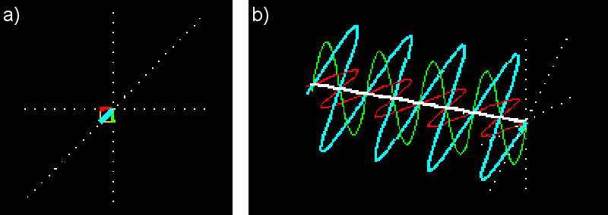
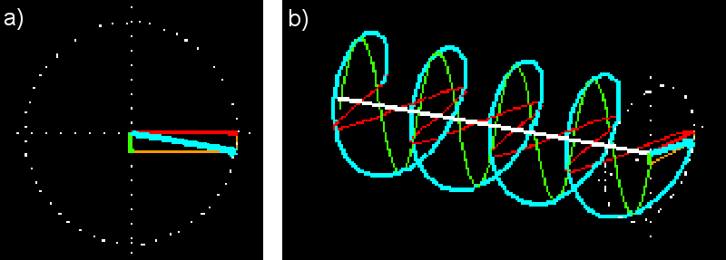
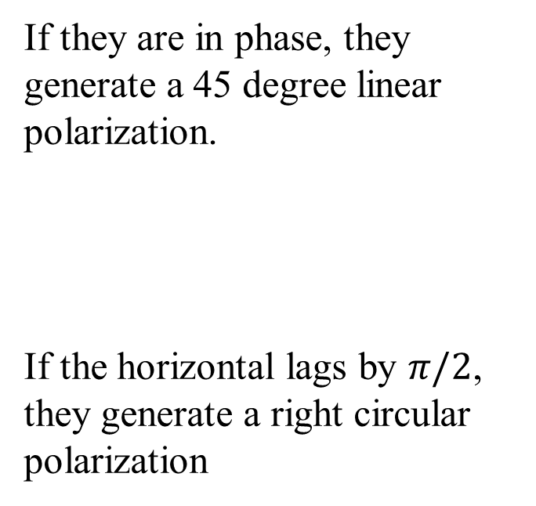
Polarizations of light
Any light polarization can be formed by the superposition of two orthogonal linear polarizations: horizontal and vertical polarization (red & green)
If they are in phase, they generate a 45 degree linear polarization.
If the horizontal lags by $π/2$, they generate a right circular polarization

Slide 2
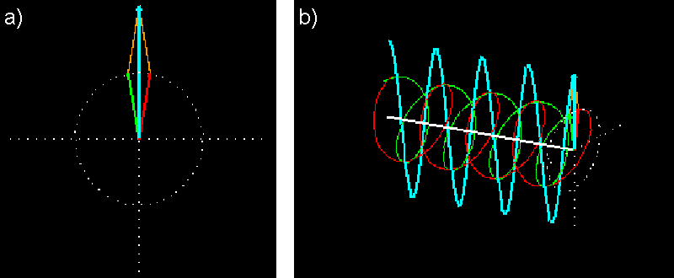
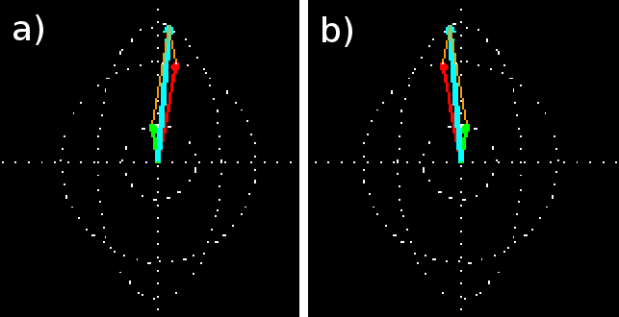
Polarizations of light
Any light polarization can also be formed by the superposition of two orthogonal circular polarizations: right- and left-circular polarization (red & green)
If they are in phase, we have
a linear polarization
If they are in phase but with different amplitude, we have a upright elliptical polarization

Slide 3
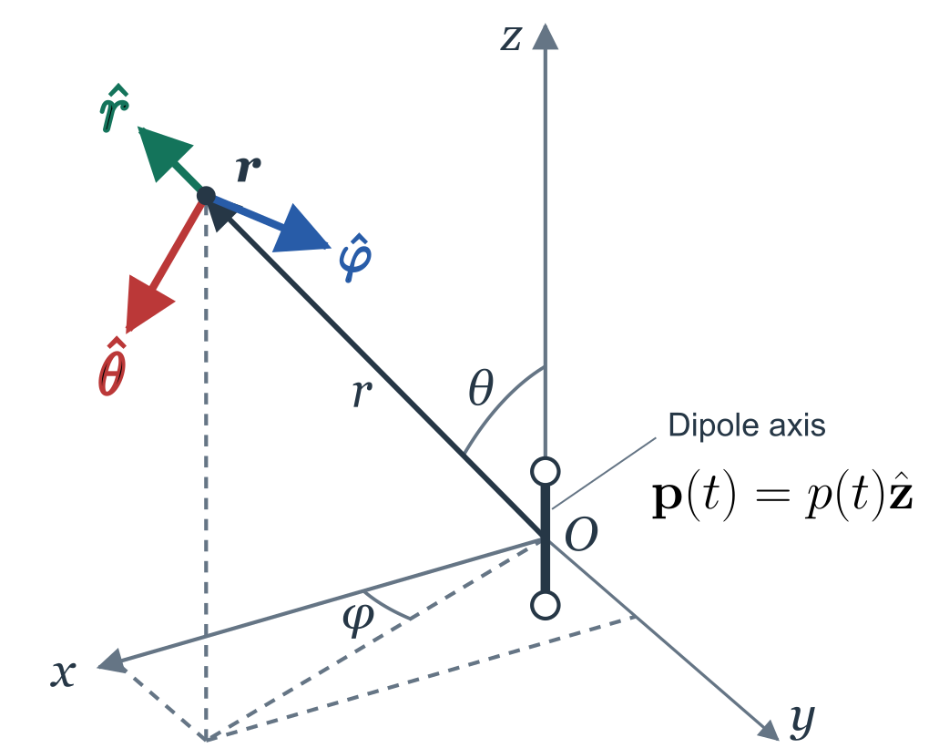
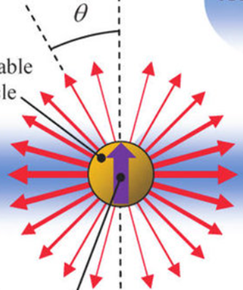
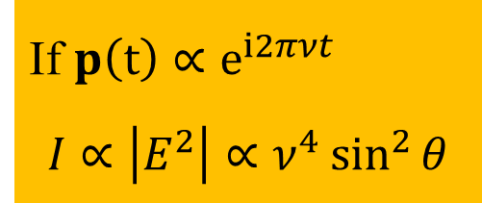
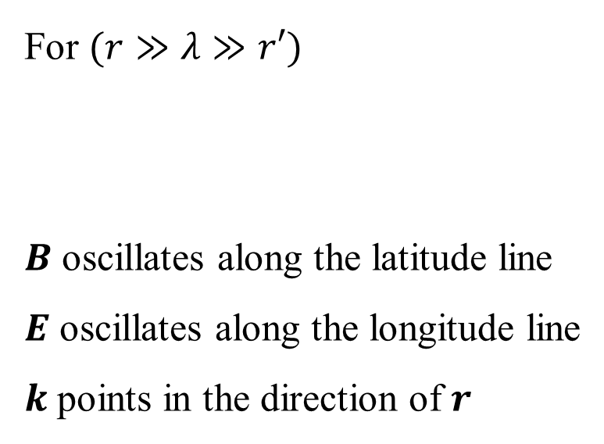
Dipole radiation
Electric Dipole: $p=qr′ r′\left(t\right):displacement of the charge at time t$
A vibrating charge induces vibrating E&M field at distance $r$
For $(r≫λ≫r′)$
$B$ oscillates along the latitude line
$E$ oscillates along the longitude line
$k$ points in the direction of $r$
If $p\left(t\right)∝e^{i2πνt}$
$$I∝\left|E^{2}\right|∝ν^{4}\sin^{2}{θ}$$

Slide 4
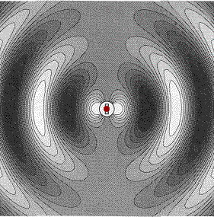
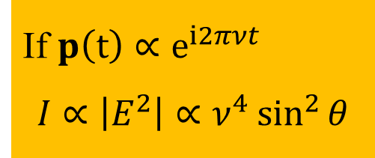
Dipole radiation
Electric Dipole: $p=qr′ r′\left(t\right):displacement of the charge at time t$
A vibrating charge induces vibrating E&M field at distance $r$
For $(r≫λ≫r′)$
$B$ oscillates along the latitude line
$E$ oscillates along the longitude line
$k$ points in the direction of $r$
If $p\left(t\right)∝e^{i2πνt}$
$$I∝\left|E^{2}\right|∝ν^{4}\sin^{2}{θ}$$

Slide 5
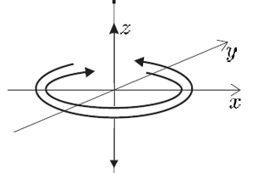
What is the electric field radiated by a rotating dipole on the x-y plane?

Slide 6
Zeeman effect （1896-97）
Zeeman studied the emission spectra of atoms in a strong magnetic field, initially observing broadening of the sodium D lines and subsequently resolving the splitting clearly in a blue cadmium spectral line.
viewed perpendicular to B, this line separated into a triplet; viewed along B, it appeared as a doublet with opposite circular polarizations

Slide 7
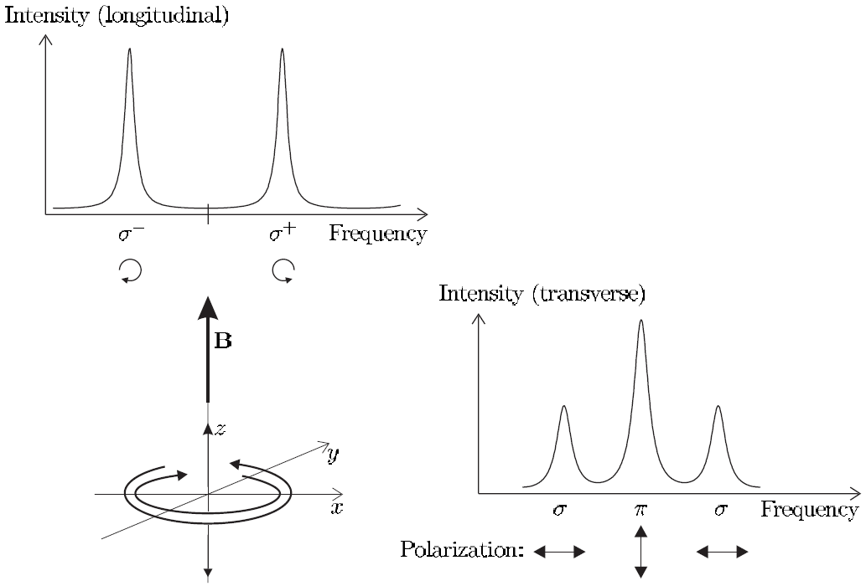

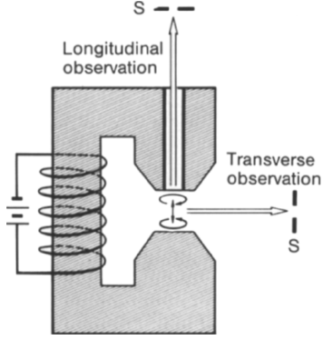
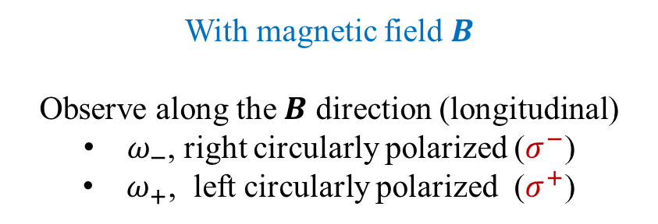

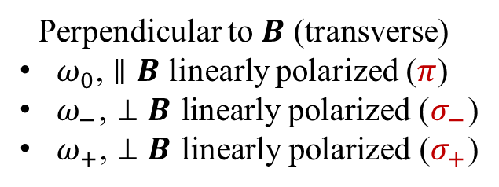

Zeeman effect and Lorentz’s explanation
No magnetic field: unpolarized fluorescence of frequency $ω_{0}$ is observed from any direction.
With magnetic field $B$
Observe along the $B$ direction (longitudinal)
$ω_{−}$, right circularly polarized ($σ^{−}$)
$ω_{+}$, left circularly polarized ($σ^{+}$)
Perpendicular to $B$ (transverse)
$ω_{0}$, $∥B$ linearly polarized ($π$)
$ω_{−}$, $⊥B$ linearly polarized ($σ_{−}$)
$ω_{+}$, $⊥B$ linearly polarized ($σ_{+}$)
$$σ^{−}$$
$$σ^{+}$$

Slide 8
Zeeman effect and Lorentz’s explanation
No magnetic field: unpolarized fluorescence of frequency $ω_{0}$ is observed from any direction.
With magnetic field $B$
Observe along the $B$ direction (longitudinal)
$ω_{−}$, right circularly polarized ($σ^{−}$)
$ω_{+}$, left circularly polarized ($σ^{+}$)
Perpendicular to $B$ (transverse)
$ω_{0}$, $∥B$ linearly polarized ($π$)
$ω_{−}$, $⊥B$ linearly polarized ($σ_{−}$)
$ω_{+}$, $⊥B$ linearly polarized ($σ_{+}$)
$$σ^{−}$$
$$σ^{+}$$

Slide 9
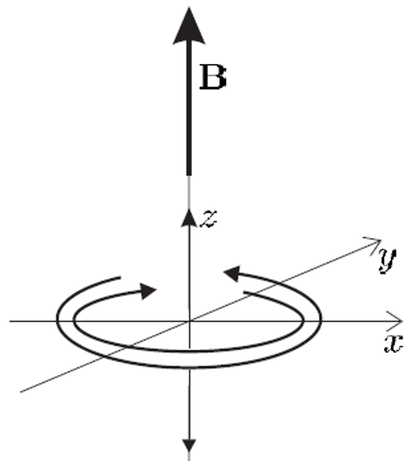
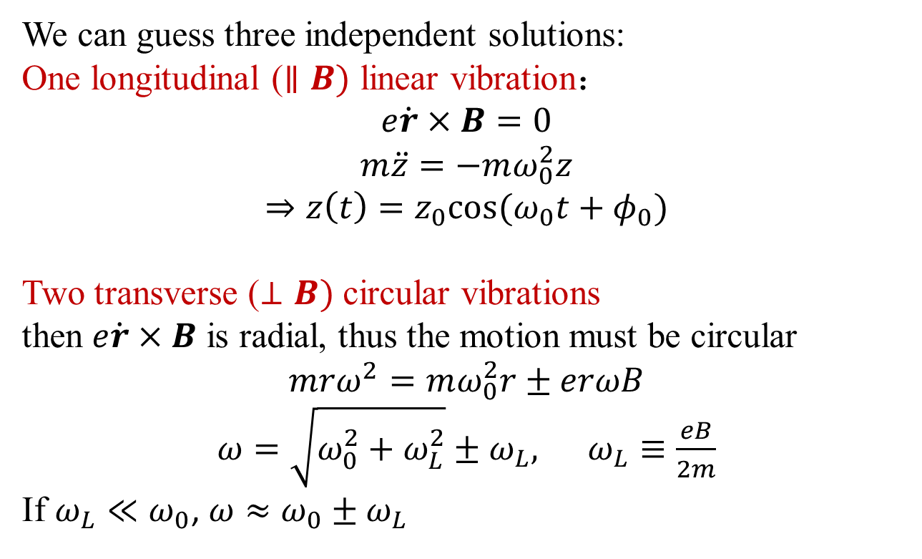
Lorentz equation:
We can guess three independent solutions:
One longitudinal ($∥B)$ linear vibration：
$$e\dot{r}×B=0$$
$$m\ddot{z}=−mω_{0}^{2}z$$
$$⇒z\left(t\right)=z_{0}cos⁡(ω_{0}t+φ_{0})$$
Two transverse ($⊥B)$ circular vibrations
then $e\dot{r}×B$ is radial, thus the motion must be circular
$$mrω^{2}=mω_{0}^{2}r±erωB$$
$ω=\sqrt{ω_{0}^{2}+ω_{L}^{2}}±ω_{L}, ω_{L}≡\frac{eB}{2m}$​​
If $ω_{L}≪ω_{0}$, $ω≈ω_{0}±ω_{L}$
Any kind of vibration is a superposition of these three eigen-vibrations. E&M radiations generated by these eigen-vibrations of electron gives the Zeeman effect.

